Slide 1
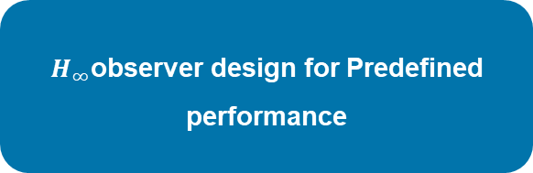
Design of Distributed Filter Based on Linear Matrix Inequality.
①
②
③
Distributed Kalman filter for low obvservability
Distributed Kalman filter for sensor heterogeneity
Distributed Kalman filter with linear/nonlinear fusion estimation
④
⑤
$H_{∞}$observer design for Predefined performance
Robust observer for external perturbations and nonlinear unmodeled dynamics
CPS Computational Learning Laboratory
1

Slide 2
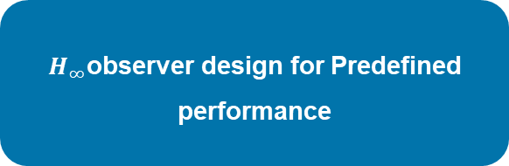
②
Distributed Kalman filter for sensor heterogeneity
①
③
Distributed Kalman filter for low obvservability
Distributed Kalman filter with linear/nonlinear fusion estimation
Information matrice
Deduce consensus gain
⑤
④
Robust observer for external perturbations and nonlinear unmodeled dynamics
$H_{∞}$observer design for Predefined performance

Slide 3

Paper 1
Distributed Kalman Filter for Weighted
Directed Graphs
Shiraz Khan , Raj Deshmukh , and Inseok Hwang
Published in: IEEE 58th Conference on Decision and Control (CDC)
Published Time: 2019
CPS Computational Learning Laboratory
3

Slide 4
01
Problem Description
02
Method Design
03
Experiment Results
Contents
04
Conclusion
CPS Computational Learning Laboratory
4
Notes:
主要分为以下四个部分

Slide 5
01
Problem Description
02
Method Design
03
Experiment Results
Contents
04
Conclusion
CPS Computational Learning Laboratory
5
Notes:
首先是问题描述

Slide 6
Problem Description
Establishment of the structural framework of distributed Kalman filter in Weighted Directed Graphs
This study proposes an optimal distributed state estimation algorithm for weighted directed graphs to improved robustness and resilience of state estimation compared to KCF and the optimality of the state estimation is guaranteed.
Challenge
Estimation performance of distributed filters is susceptible to the communication environment.
The statement estimation solutions obtained are difficult to prove optimality.
Method
The optimal Kalman gain and optimal weight gain are obtained by taking the partial derivative of the trace of the covariance matrix.
CPS Computational Learning Laboratory
6

Slide 7
01
Problem Description
02
Method Design
03
Experiment Results
Contents
04
Conclusion
CPS Computational Learning Laboratory
7

Slide 8
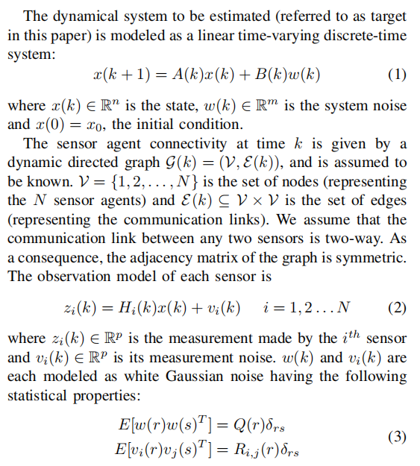
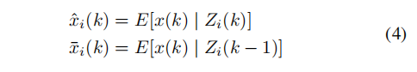
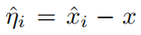
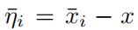
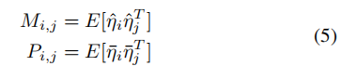
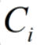
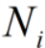
Method Design
①Define the posterior and prior estimate of the target state:
②Define the posterior and prior estimate errors of the target state:
③Define the cross covariance matrices of the estimation errors:
④Define the relevant symbols in this paper:
(1) is the Kalman consensus gain for sensor i.
(2) is the set of first-degree neighbors of sensor i.
CPS Computational Learning Laboratory
8

Slide 9
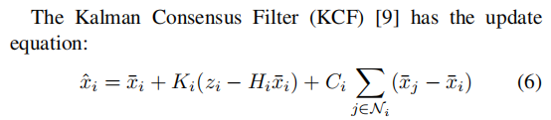
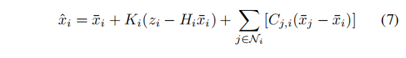
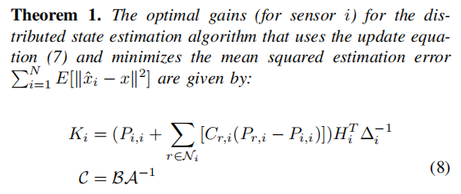
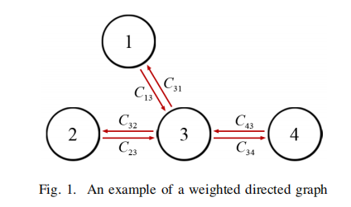
Method Design
先验估计
新息
共识估计项
The parameter solvability condition that makes Eq. (7) solvable under the MMSE criterion is obtained as:
But this estimation performance of this distributed filter is susceptible to the communication environment and the optimality of the solution is not guaranteed.
CPS Computational Learning Laboratory
9

Slide 10
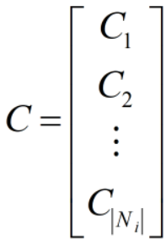
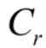
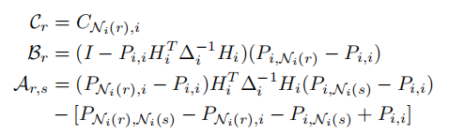
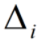
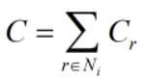

Method Design
注：
表示各分布式滤波器的共识增益集合
Among them:
表示对于分布式滤波器i，在i的邻居集$N_{i}$中的
第r个分布式滤波器对i提供估计信息的贡献
表示在对分布式滤波器i计算后验状态估计时的总不确定度（先验协方差与观测噪声共同的影响）
$N_{i}(r)$ is the r-th element of the set $N_{i}$
CPS Computational Learning Laboratory
10

Slide 11
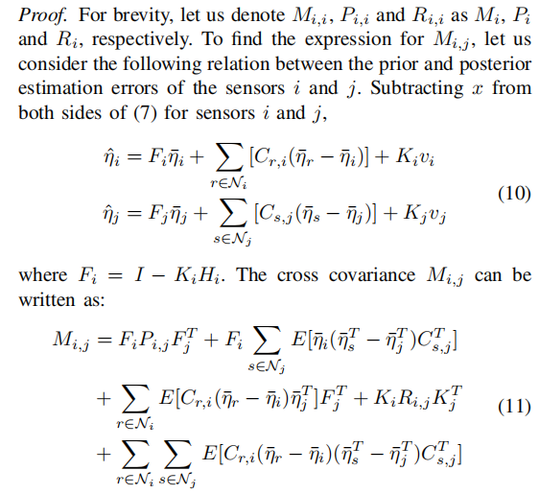
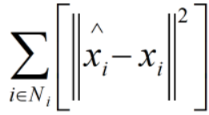
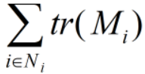
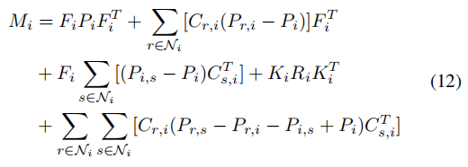
Method Design
MMSE
criterion
Substituting the outer product terms with the corresponding covariance matrices：
CPS Computational Learning Laboratory
11

Slide 12
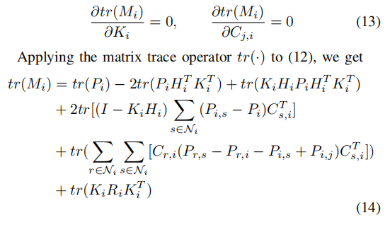
Method Design
Partial derivative the trace of the a posteriori covariance matrix for eliminating the outer product
CPS Computational Learning Laboratory
12

Slide 13
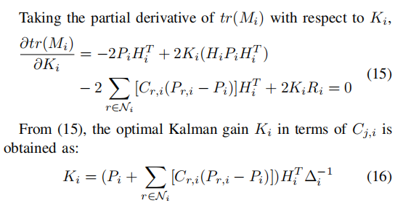
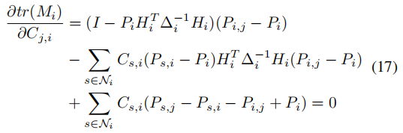
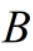
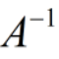
Method Design
Bringing Eq. (16) into Eq. (12) gives：
注：相比于集中式kalman滤波器，分布式kalman滤波器的卡尔曼增益增加了由于共识滤波器引入的协方差矩阵，由此说明引入分布式滤波器有助于后验状态估计更加趋向于真值逼近。
CPS Computational Learning Laboratory
13

Slide 14
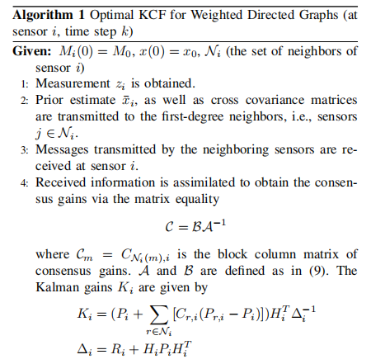
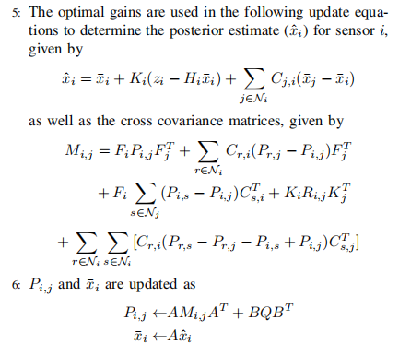
Method Design
CPS Computational Learning Laboratory
14

Slide 15
01
Problem Description
02
Method Design
03
Experiment Results
Contents
04
Conclusion
CPS Computational Learning Laboratory
15

Slide 16
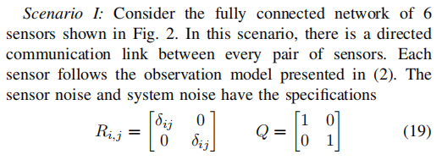
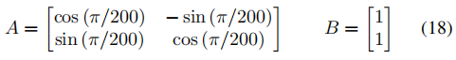
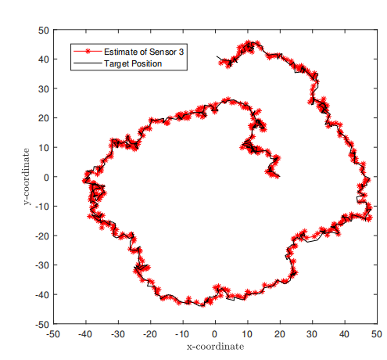
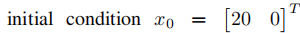
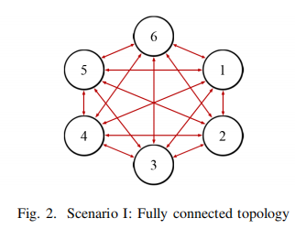
Experiment Results
Setting 1（Fully connected topology track）
A target moves in a circular path over a sensor network. The target is subject to system noise that causes its trajectory to be perturbed. The system with the following matrices:
CPS Computational Learning Laboratory
16

Slide 17
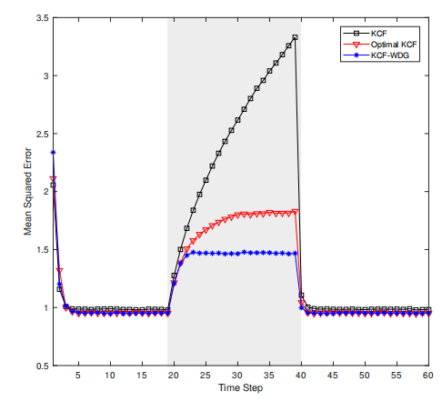
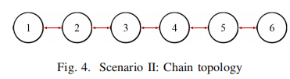
Experiment Results
Setting 2
（chain topology track）
We have performed 10,000 Monte Carlo simulations, and
in Fig. 5, the mean squared estimation error is plotted for：
In this simulation, the sensor network has a chain topology (as presented in Fig. 4), in which there are 6 sensors connected in series. The sensors at either end (1 and 6) have only one first-degree neighbor (2 and 5, respectively)
Each sensor is locally observability
CPS Computational Learning Laboratory
17

Slide 18
01
Problem Description
02
Method Design
03
Experiment Results
Contents
04
Conclusion
CPS Computational Learning Laboratory
18
CPS Computational Learning Laboratory
2
18

Slide 19
Conclusion
①
This paper design a weighted directed graph distributed Kalman filter algorithm,this algorithm not require any assumptions on the observability of the individual sensors.
②
This paper discussed the suboptimality in existing schemes and the validate the superior algorithm performance of the proposed scheme against the existing algorithms.
CPS Computational Learning Laboratory
19

Slide 20
Paper 2
Optimal Kalman Filter With Information-Weighted Consensus
Shiraz Khan , Raj Deshmukh , and Inseok Hwang
Publish Journal:IEEE Transections On Automatics Control(TAC)
Published Time: 2023
CPS Computational Learning Laboratory
20
Notes:
基于深度强化学习的柔性作业车间动态调度

Slide 21
01
Problem Description
02
Method Design
03
Experiment Results
Contents
04
Conclusion
CPS Computational Learning Laboratory
21
Notes:
主要分为以下四个部分

Slide 22
01
Problem Description
02
Method Design
03
Experiment Results
Contents
04
Conclusion
CPS Computational Learning Laboratory
22
Notes:
首先是问题描述

Slide 23
Problem Description
Distributed Kalman filter with heterogeneous sensors system
This study designed a distributed weighted consensus Kalman filter algorithm, this algorithm is able to achieve a directional flow of information in heterogeneous sensor networks. By incorporating consensus on a weighted directed graph (WDG), the proposed algorithm enables sensors to selectively assign higher weightage to accurate information and lower weightage to inaccurate or redundant information.
Challenge
How to assign the consensus weights in case of poor sensor performance (heterogeneous sensor networks scenario)?
Method
The derivation of optimal Kalman gain is achieved by minimizing the root-mean-square error, and the information matrix is used to measure the estimation performance of each sensor to derive the optimal weight gain.
CPS Computational Learning Laboratory
23

Slide 24
01
Problem Description
02
Method Design
03
Experiment Results
Contents
04
Conclusion
CPS Computational Learning Laboratory
24
Notes:
研究现状

Slide 25
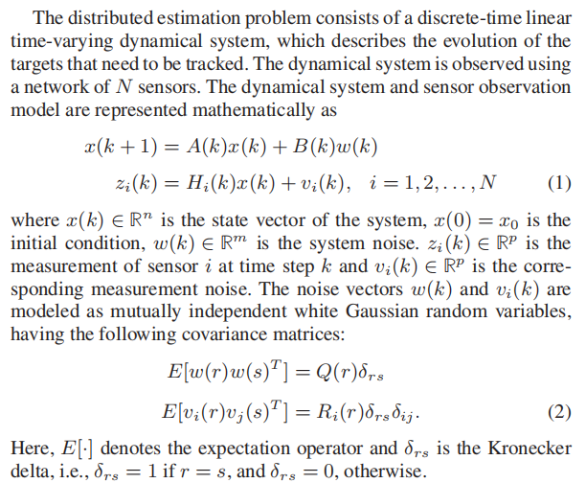
Method Design
①Define the posterior and prior estimate of the target state:
②Define the posterior and prior estimate errors of the target state:
③Define the cross covariance matrices of the estimation errors:
④Define the relevant symbols in this paper:
(1) is the Kalman consensus gain for sensor i.
(2) is the set of first-degree neighbors of sensor i.
CPS Computational Learning Laboratory
25

Slide 26
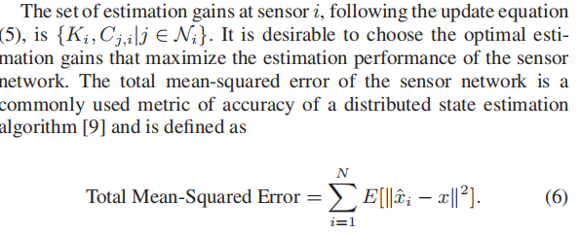
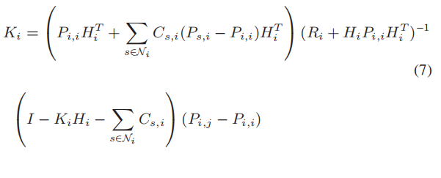
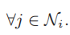
Method Design
Theorem 1: The distributed estimation algorithm following the update equation (5) minimizes the total mean-squared error (6) at each time step if and only if the following conditions are satisfied at all sensors in the network:
注：卡尔曼增益K代表滤波器更新机制，其只与优化准则有关，不与其他因素有关。
之后需要求解在异构传感器环境下的共识权值
CPS Computational Learning Laboratory
26

Slide 27
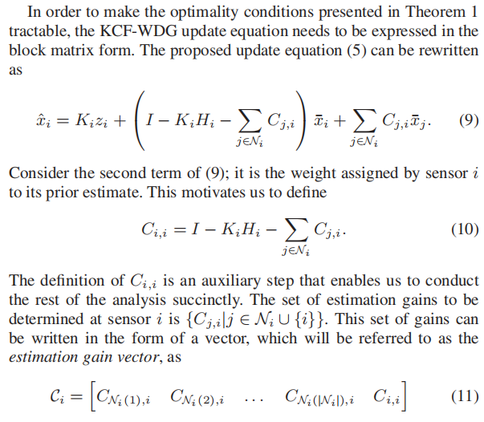
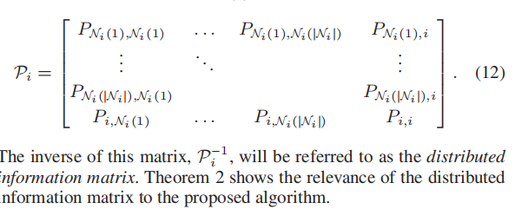
Method Design
注：将分布式滤波器更新公式式（5）改写成式（9）的形式，为了后续推导选择传感器提供先验信息更重要的共识权重提供方便。
注：即协方差较小的传感器将具有较高的可靠性，将分配更高的权重。因此定义信息矩阵来衡量传感器性能的可靠性。
CPS Computational Learning Laboratory
27

Slide 28
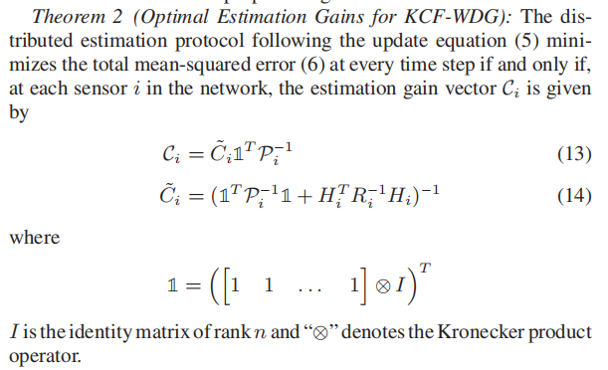
Method Design
注：式（14）代表总不确定性，包括观测噪声和各传感器引入先验协方差矩阵共同的影响。
CPS Computational Learning Laboratory
28

Slide 29
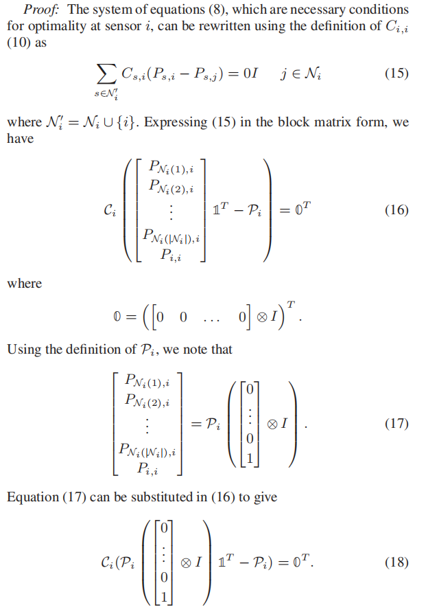
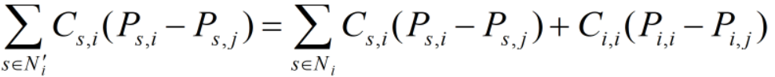
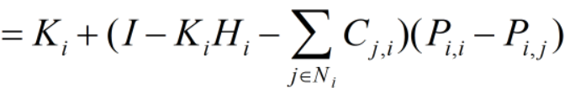
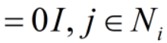
Method Design
注：这里只考虑与传感器i有关的先验协方差，即只保留输入
传感器i的协方差矩阵
CPS Computational Learning Laboratory
29

Slide 30
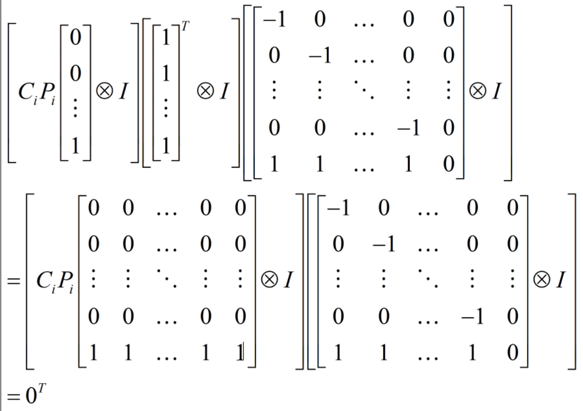
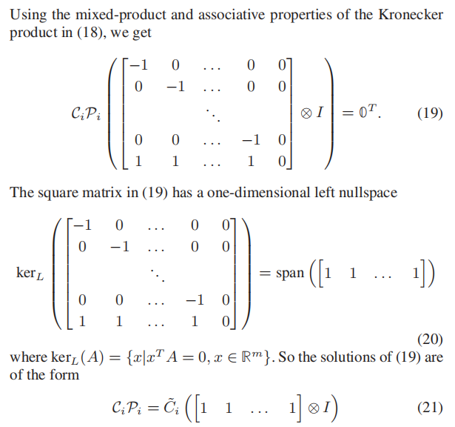
Method Design
式（20）代表此矩阵的特征向量为全1向量
之后需要求解式（21）中的
CPS Computational Learning Laboratory
30

Slide 31
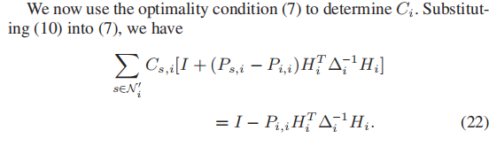





Method Design
注：利用先前推导的与协方差无关的卡尔曼增益表达式作为已知条件，将 解出。
31
CPS Computational Learning Laboratory

Slide 32






Method Design
The estimation error covariance can be obtained by substituting (9), (28), and (29) into (3), as
CPS Computational Learning Laboratory
32

Slide 33
01
Problem Description
02
Method Design
03
Experiment Results
Contents
04
Conclusion
CPS Computational Learning Laboratory
33

Slide 34





Experiment Results
In this section, the Optimal KCF-WDG algorithm is validated and its estimation performance is compared against those of existing algorithms through an illustrative numerical simulation. We consider the problem of target tracking using a network of cameras, which is an example of a distributed estimation scenario.
The initial value of
the state vector is
The FoV of each camera (depicted by the yellow shaded region) is a triangle with an apex angle of 70◦ and height of 70 m, such that the apex of the triangle lies on the sensor.
The process noise covariance
CPS Computational Learning Laboratory
34

Slide 35



Experiment Results
CPS Computational Learning Laboratory
35

Slide 36
01
Problem Description
02
Method Design
03
Experiment Results
Contents
04
Conclusion
CPS Computational Learning Laboratory
36
CPS Computational Learning Laboratory
2
18

Slide 37
Future Work
Contributions
In this article, a novel distributed estimation algorithm has been proposed, which extends the KCF to incorporate weighted consensus. the estimation gains of OKCF-WDG were optimized at each sensor to achieve the minimum mean-squared error in the heterogeneous sensor networks distributed setting.
Future Work
The future work on OKCF-WDG would look into formalizing the estimation of the distributed information matrix such that it can be estimated efficiently in terms of computing and communication costs. A formal stability analysis of the algorithm will also be conducted.
CPS Computational Learning Laboratory
37

Slide 38
Paper 3
A New Approach to Linear/Nonlinear Distributed
Fusion Estimation Problem
Bo Chen ,Guoqiang Hu , Daniel W.C. Ho , and Li Yu
Publish Journal:IEEE Transections On Automatics Control(TAC)
Published Time: 2024
CPS Computational Learning Laboratory
38

Slide 39
01
Problem Description
02
Method Design
03
Experiment Results
Contents
04
Conclusion
CPS Computational Learning Laboratory
39
Notes:
主要分为以下四个部分

Slide 40
01
Problem Description
02
Method Design
03
Experiment Results
Contents
04
Conclusion
CPS Computational Learning Laboratory
40

Slide 41
Problem Description
Collaborative multi-view IB for flexible unsupervised representation learning
In this paper, we study the distributed fusion estimation problem for linear time-varying systems and nonlinear systems with bounded noises.
Challenge
the disturbance noises in practical systems are always bounded, and the statistical property of noises is difficult to be accurately obtained in practical applications.
Method
The novel constructive proposed to find an upper bound of fusion estimation error, then a convex optimization problem on the design of an optimal weighting fusion criterion is established in terms of linear matrix inequalities, which can be solved by standard software packages.
CPS Computational Learning Laboratory
41

Slide 42
01
Problem Description
02
Method Design
03
Experiment Results
Contents
04
Conclusion
CPS Computational Learning Laboratory
42
Notes:
研究现状

Slide 43




Method Design
Nonlinear system dynasic model:
注：针对一般情况的白噪声，满足：
即能量函数无界。本论文考虑在有界情况的噪声（非白噪声）下的状态估计问题。
Among them:
is the system state;
is the measured output from sensor i;
L is the number of sensors
are time-varying bounded matrices.
satisfied:
CPS Computational Learning Laboratory
43

Slide 44




Method Design
Local state estimator(LSE):
Among them:
denotes one-step prediction;
denotes optimal gains;
注：将非线性系统局部线性化，化简为近似扩展卡尔曼滤波器的形式
CPS Computational Learning Laboratory
44

Slide 45

Method Design
Distributed fusion estimate(DFE):
注：
（1）首先需要设计最优增益K，使得平方根误差存在上界；
（2）之后需要设计权重增益，使最小化SE的值。
CPS Computational Learning Laboratory
45

Slide 46




Method Design
①DFE Design for Linear Time-Varying Systems
Before deriving the result of Theorem 1, define:
注：式（11）为保证平方根误差有界的最优增益K求解方法；
式（13）为保证平方根误差最小化的权重参数求解方法。
CPS Computational Learning Laboratory
46

Slide 47


Method Design
CPS Computational Learning Laboratory
47

Slide 48


Method Design
证明平方根误差有界
CPS Computational Learning Laboratory
48

Slide 49


Method Design
证明平方根误差最小化的优化目标
需利用schur补引理确保将此线性矩阵不等式转化为计算机可解的形式
CPS Computational Learning Laboratory
49

Slide 50





Method Design
CPS Computational Learning Laboratory
50

Slide 51

Method Design
②DFE Design for Linear Time-Varying Systems
注：将问题拓展到非线性系统，用扩展卡尔曼滤波的方式将非线性系统在平衡点处局部线性化。
CPS Computational Learning Laboratory
51

Slide 52


Method Design
注：式（28）为保证平方根误差有界的最优增益K求解方法；
式（30）为保证平方根误差最小化的权重参数求解方法。
CPS Computational Learning Laboratory
52

Slide 53


Method Design
注：此证明过程与线性时变系统类似。
CPS Computational Learning Laboratory
53

Slide 54




Method Design
Solved by the function “mincx” of MATLAB LMI Toolbox
CPS Computational Learning Laboratory
54

Slide 55
01
Problem Description
02
Method Design
03
Experiment Results
Contents
04
Conclusion
CPS Computational Learning Laboratory
55

Slide 56


Experiment Results
A. Target Tracking System
CPS Computational Learning Laboratory
56

Slide 57



Experiment Results
Under the Type I, SEs of the H∞ filter and the LSE in this paper.
Under the Type II, Ses of the Kalman filter and the LSE in this paper.
Under the Type II, PMSEs of the LSE in this paper and the Kalman filters with knowncovariances and unknown covariances.
Under the Type III,SEs of the LSE in [21], and the LSE in this paper.
CPS Computational Learning Laboratory
57

Slide 58
01
Problem Description
02
Method Design
03
Experiment Results
Contents
04
Conclusion
CPS Computational Learning Laboratory
58
CPS Computational Learning Laboratory
2
18

Slide 59
Future Work
Contributions
1.For the linear time-varying systems, a new stable local Kalman like estimator, is obtained by solving a convex optimization problem at each time step. Subsequently, by constructing a new upper bound of fusion estimation error, an optimal distributed fusion criterion is designed by solving a class of convex optimization problems.
2.Linearizing the nonlinear function using Taylor series expansion, and the linearized errors can be viewed as bounded noises. According to the design method of linear time-varying fusion systems, each local nonlinear estimator and a distributed fusion criterion are designed by establishing different convex optimization problems.
Future Work
when considering the communication uncertainties including bandwidth constraints, transmission delays and packet dropouts, one of our future works will focus on how to design the networked nonlinear fusion estimation algorithms based on the developed fusion estimation method in this paper.
CPS Computational Learning Laboratory
59

Slide 60
Paper 4
Dynamical robust H-infinite filtering for nonlinear
uncertain systems: An LMI approach
Masoud Abbaszadeha, Horacio J. Marquez
Published in:Journel of the Franklin Institute
Published Time: 2012
CPS Computational Learning Laboratory
60

Slide 61
01
Problem Description
02
Method Design
03
Experiment Results
Contents
04
Conclusion
CPS Computational Learning Laboratory
61
Notes:
主要分为以下四个部分

Slide 62
01
Problem Description
02
Method Design
03
Experiment Results
Contents
04
Conclusion
CPS Computational Learning Laboratory
62
Notes:
首先是问题描述

Slide 63

Problem Description
$H_{∞}o$bserver design for prespecified decay rate convergence with LMI method
This paper consider a prespecified decay rate guaranteeing the exponential convergence of the estimations. In addition, when the static-gain observer also exists,the maximum admissible Lipschitz constant obtained using the proposed dynamical observer structure can be much larger than that of the static-gain observer. The achieved $H_{∞}$ observer guarantees asymptotic stability of the error dynamics with a prespecified decay rate (exponential convergence)
Method
this paper have propose an LMI approach to nonlinear $H_{∞}$ filtering in which the Lipschitz constant is one of the LMI variables in order to achieve a maximized admissible Lipschitz constant through convex optimization for systems with uncertainties in linear and nonlinear parts of the state space realization.
CPS Computational Learning Laboratory
63

Slide 64
01
Problem Description
02
Method Design
03
Experiment Results
Contents
04
Conclusion
CPS Computational Learning Laboratory
64
Notes:
研究现状

Slide 65

Method Design
（1）continuous-time uncertain nonlinear systems
注：满足lipschiz条件的函数的在某方向上斜率均不大于其方向上的lipschiz常数
CPS Computational Learning Laboratory
65
Notes:
图1给出了所提出的HMAPPO在不同时空水平上的总体操作机制。objective agent充当周期性地调整较高目标的较高控制器。作业智能体和机器智能体是底层执行者，在每个重调度点分别选择可行的作业选择规则和机器分配规则，以达到更高的目标。

Slide 66

Method Design
（1）continuous-time uncertain nonlinear systems
CPS Computational Learning Laboratory
66

Slide 67

Method Design
（2）Observer structure
注：式（10）建立为带状态反馈的龙伯格观测器形式
CPS Computational Learning Laboratory
67

Slide 68


Method Design
注：将式(2)和式(9)代入(13)中，得到观测器误差传递方程(14),(15)
CPS Computational Learning Laboratory
68

Slide 69


Method Design
Prove observer error dynamics lipschitz property
注：矩阵的L2范数计算：
CPS Computational Learning Laboratory
69

Slide 70



Method Design
Disturbance attenuation level and guaranteed decay rate
satisfied
$$\dot{ξ}\left(t\right)=\dot{A}ξ\left(t\right)+S_{1}Ω(ξ,u)$$
之后需要利用lyapunov方程建立满足上式成立下lipschitz常数$γ$的上界
CPS Computational Learning Laboratory
70

Slide 71





Method Design
$H_{∞}$ observer synthesis
CPS Computational Learning Laboratory
71

Slide 72





Method Design
注：通过式（29）保证$H_{∞}$性能
CPS Computational Learning Laboratory
72

Slide 73



Method Design
注：对于式（33）而言，需要分为两部分对式子进行放缩，从而找到上界。
CPS Computational Learning Laboratory
73

Slide 74




Method Design
注：通过添加变量表示更加直接，且防止在定理1求解凸优化问题时对$α_{1}$过定义。
①
注：利用矩阵分解方法，并构造引理2的形式，使得矩阵可以化为对称二次型形式，方便后续schur补引理化简为LMI形式
CPS Computational Learning Laboratory
74

Slide 75




















Method Design
For:
利用式①对下式黄色部分进行放缩：
利用lamma1和lamma2对蓝色部分进行放缩，即：
CPS Computational Learning Laboratory
75

Slide 76

Method Design
由此可得：
CPS Computational Learning Laboratory
76

Slide 77




Method Design
对于：
satisfied
$$\dot{ξ}\left(t\right)=\dot{A}ξ\left(t\right)+S_{1}Ω(ξ,u)$$
Define Lyapunov function
注：为使系统按衰减速率收敛，则需保证lyapunov函数满足 。
Derivation with respect to time
Solving following differential equations
①
②
CPS Computational Learning Laboratory
77

Slide 78


Method Design
①
②
联立式①②，得：
针对先前推导的误差动力学方程（15）,有：
CPS Computational Learning Laboratory
78

Slide 79

Method Design
注：式（42）保证了误差方程e(t)具有衰减率$β$动态过程
CPS Computational Learning Laboratory
79

Slide 80



Method Design
Schur complements lamma：
define：
Schur lamma
define：
Schur lamma
define：
CPS Computational Learning Laboratory
80

Slide 81







Method Design
将式（39）通过schur补转化为LMI形式，得到式（43）：
对于nominal system,其w=0。
其中：
CPS Computational Learning Laboratory
81

Slide 82
Method Design
CPS Computational Learning Laboratory
82

Slide 83


Method Design
Robustness against nonlinear uncertainty
CPS Computational Learning Laboratory
83

Slide 84
01
Problem Description
02
Method Design
03
Experiment Results
Contents
04
Conclusion
CPS Computational Learning Laboratory
84

Slide 85

Experiment Results
注：可以看到本论文使用的观测器设计方法的容许lipschitz常数相比之前研究有明显增加，即说明设计的观测器的保守性有所降低，且具有渐进鲁棒性。
CPS Computational Learning Laboratory
85

Slide 86
01
Problem Description
02
Method Design
03
Experiment Results
Contents
04
Conclusion
CPS Computational Learning Laboratory
86
CPS Computational Learning Laboratory
2
18

Slide 87

Future Work
Contributions
This paper consider a prespecified decay rate guaranteeing the exponential convergence of the estimations. It will be shown that the proposed dynamical structure has additional degrees of freedom when compared to theconventional static-gain observers and is capable of robustly stabilizing the observer error dynamics for some of those systems for which a static-gain observer cannot be found.
In addition, when the static-gain observer also exists,the maximum admissible Lipschitz constant obtained using the proposed dynamical observer structure can be much larger than that of the static-gain observer. The achieved $H_{∞}$ observer guarantees asymptotic stability of the error dynamics with a prespecified decay rate (exponential convergence)
CPS Computational Learning Laboratory
87

Slide 88
Paper 5
An LMI-Based Robust Nonlinear Adaptive Observer for Disturbed Regression Models
Héctor Ríos , Alejandra Ferreira de Loza , Denis Efimov and Roberto Franco
Publish Journal:IEEE Transections On Automatics Control(TAC)
Published Time: 2024
CPS Computational Learning Laboratory
88

Slide 89
01
Problem Description
02
Method Design
03
Experiment Results
Contents
04
Conclusion
CPS Computational Learning Laboratory
89
Notes:
主要分为以下四个部分

Slide 90
01
Problem Description
02
Method Design
03
Experiment Results
Contents
04
Conclusion
CPS Computational Learning Laboratory
90
Notes:
首先是问题描述

Slide 91
Problem Description
Robust LMI method for disturbed regression models observer design
This paper contributes with an adaptive observer for a class of disturbed dynamical regression models and algorithm deals with the time-varying parameter identification problem.
Challenge
Any parameter identification procedure relevant to real applications must deal with disturbances comprising time-dependent perturbations and disregarded dynamics.
Method
The gain tuning of the algorithm is constructive, and it is based on the solution of a set of LMIs. And through LMI method
making the Lyapunov equation negative definite.
CPS Computational Learning Laboratory
91
Notes:
任何与实际应用相关的参数识别过程都必须处理包含与时间相关的扰动和忽略动力学的扰动

Slide 92
01
Problem Description
02
Method Design
03
Experiment Results
Contents
04
Conclusion
CPS Computational Learning Laboratory
92
Notes:
研究现状

Slide 93



Method Design
Problem statement:
注：对于状态不可完全观测系统，系统参数数量大于可用于测量的状态数，即p>m ,因此需要假设可测输出和不确定参数相关性质。
Assumtion:
(1)
is the output available for measurement
(2)
is a continuous function of time, which is measurable
在存在依赖于时间的外部扰动和非线性未建模动力学，需要使用可测输出y和回归向量Γ识别时间变化参数θ的向量
(3)
is the vector of unknown time-varying parameters
represents unmeasurable disturbances comprising time
(4)
dependent external perturbations and nonlinear unmodeled dynamics
(5)
w is locally Lipschitz continuous function of y and piecewise continuous in t
(6)
CPS Computational Learning Laboratory
93
Notes:
表示由时间相关的外部扰动组成的非线性扰动和非线性非建模动力学

Slide 94


Method Design
Robust Nonlinear Adaptive Observer:
Assumtion:
(1)
is the estimation output y
注：将式（1）中的动力学模型带入自适应观测器中，得到误差动力学方程，因此只需对此方程的稳定性和收敛性进行分析。
(2)
is the estimation output error
(3)
(4)
define the function
(5)
and β > 1
(6)
CPS Computational Learning Laboratory
94
Notes:
扰动的影响出现在状态估计误差动力学中，而参数变化的影响出现在参数识别误差方程中。

Slide 95

Method Design
假设2引入输出y的不同次幂和范数相关的项，以及一个非负常数项w。明确扰动的可处理性，同时涵盖了多类型的扰动（大扰动、小扰动、随机扰动）。
The disturbance terms
are compensated by the observer terms
之后证明自适应观测器在扰动满足假设2下的稳定性和收敛性
CPS Computational Learning Laboratory
95
Notes:
上界也考虑了不消失的时变外部扰动，它以w+为界。因此，假设2对大量的扰动都是有效的。

Slide 96

Method Design
CPS Computational Learning Laboratory
96

Slide 97


Method Design
CPS Computational Learning Laboratory
97

Slide 98



Method Design
CPS Computational Learning Laboratory
98

Slide 99


Method Design
CPS Computational Learning Laboratory
99

Slide 100

Method Design
CPS Computational Learning Laboratory
100

Slide 101
01
Problem Description
02
Method Design
03
Experiment Results
Contents
04
Conclusion
CPS Computational Learning Laboratory
101

Slide 102



Experiment Results
The solution to the given LMIs is obtained by means of SDPT3 solver, among YALMIP in MATLAB.
(1)The time-varying parameters satisfy Assumption 1:
(2)Follow the Algorithm 1 to compute the observer parameters:
(3)Follow the LMI parameters:
CPS Computational Learning Laboratory
102

Slide 103





Experiment Results
(3)Follow the LMI parameters:
(4)Consider the initial conditions
CPS Computational Learning Laboratory
103

Slide 104



Experiment Results
CPS Computational Learning Laboratory
104

Slide 105
01
Problem Description
02
Method Design
03
Experiment Results
Contents
04
Conclusion
CPS Computational Learning Laboratory
105
CPS Computational Learning Laboratory
2
18

Slide 106
Future Work
Contributions
1.This algorithm counteracts the effects of the disturbances comprising time-dependent external perturbations and
nonlinear unmodeled dynamics;
2. The parameter identification error converges asymptotically to a region around the origin, which can be made acceptably small by a proper tuning of design parameters;
3. The gains synthesis of the algorithm is constructive since it is based on the solution of a set of linear matrix inequalities (LMIs).
CPS Computational Learning Laboratory
106

Slide 107
Thank you for listening

